Slide 1
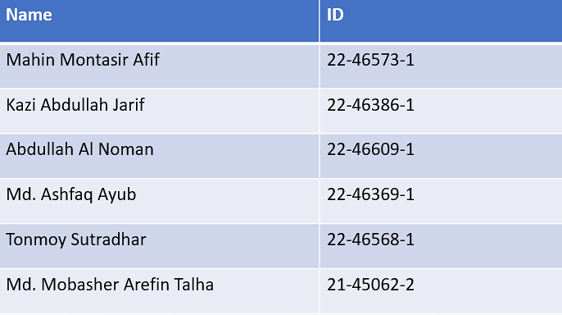
An Integrated Smart Pond Water Quality Monitoring and Fish Farming Recommendation Aquabot System

Slide 2
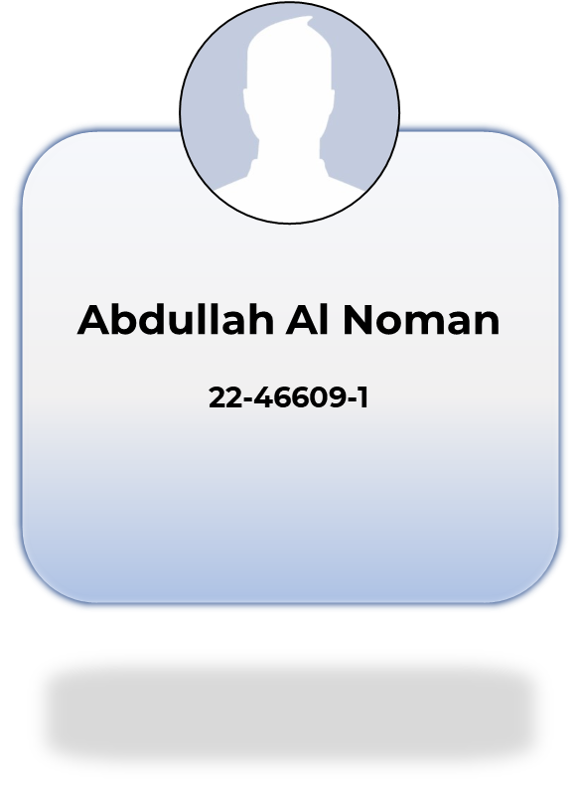

Slide 3
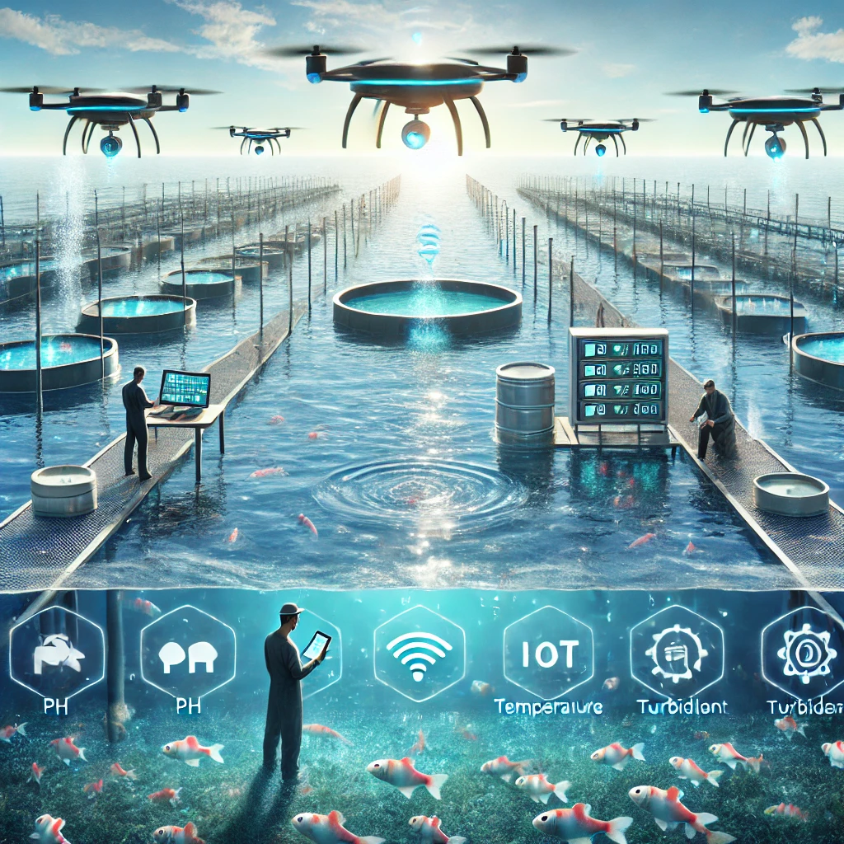
Topic of Interest
Smart fish farming has emerged as a promising approach to enhance the productivity, sustainability, and efficiency of aquaculture by integrating Internet of Things (IoT) and machine learning technologies.

Slide 4
Problem Statement
Manual Labor
Inaccurate Data
Time Lags
Traditional methods often involve manual sampling and testing, requiring significant time, effort, and expertise.
Manual measurements can be prone to errors and inconsistencies, leading to inaccurate data and unreliable insights.
Data collection and analysis can be time-consuming, resulting in delays in identifying and addressing water quality issues.

Slide 5
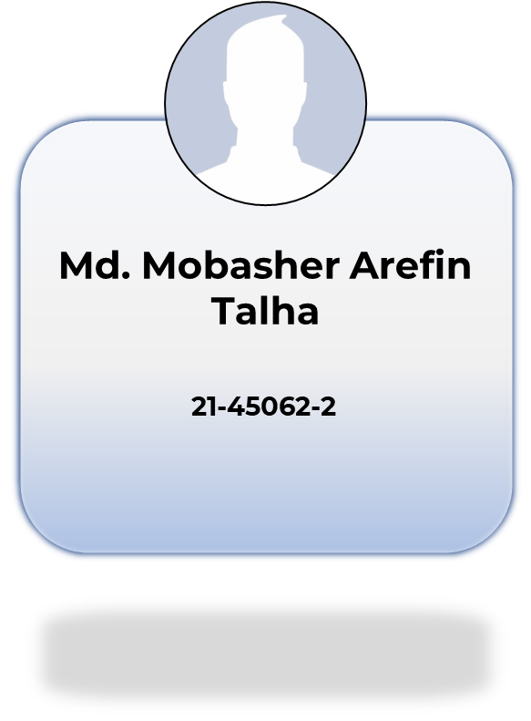

Slide 6
Defining the Purpose
Objective
01
02
To look into how well machine learning systems forecast appropriate fish species using data on water quality in real time.
To look into how IoT-based real-time water quality monitoring devices might enhance sustainability and decision-making in fish farming.

Slide 7
Primary Research Question
How can the recommendation of fish species for sustainable aquaculture be enhanced by the combination of machine learning algorithms and Internet of Things-based water quality monitoring?

Slide 8
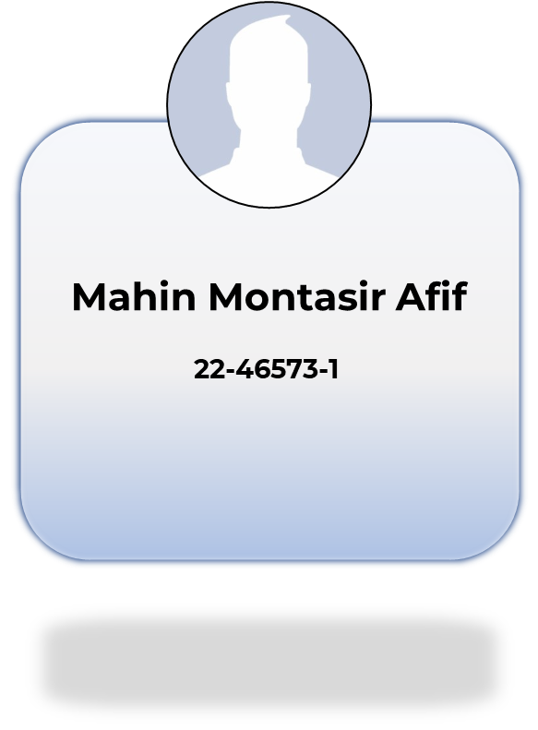

Slide 9
Hypothesis
The integration of IoT-based real-time water quality monitoring and machine learning for fish species recommendation will significantly improve the productivity and sustainability of fish farming by providing accurate, data-driven decisions for water quality management and species selection.

Slide 10
Literature Review
1
IoT-based Water Quality Monitoring in Fish Farming:
2
Machine Learning for Fish Species Recommendations:
Some work has been done on monitoring Water
Quality in fish farming by other researchers. [4], [5]
Machine Learning integration in Fish Farming has been a growing trend now.[3], [4]
3
IoT and Renewable Energy Integration
in Smart Aquaculture:
4
Smart Pond Management Using Robotics:
Integrating IoT for renewable energy has been seen very efficient nowadays. [7], [12]
Robotics has been used as a pond monitoring tool.[2], [6]

Slide 11
Research Gaps & Future Directions:
While numerous studies have explored the application of IoT and machine learning in fish farming, several gaps remain in the literature. Integration of all the tools like machine learning, IoT, Solar power for renewable energy can be a very good combination for a smart Fish Farming.

Slide 12
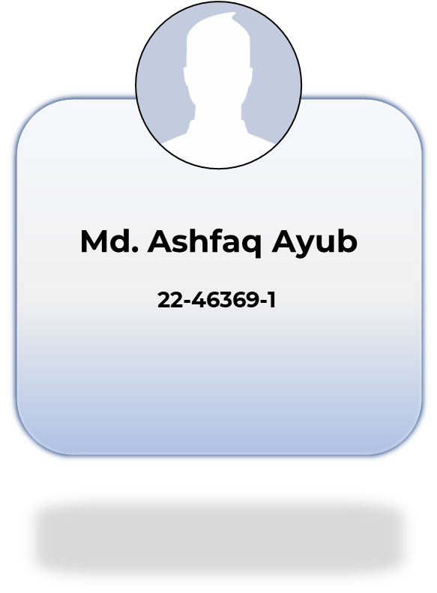

Slide 13
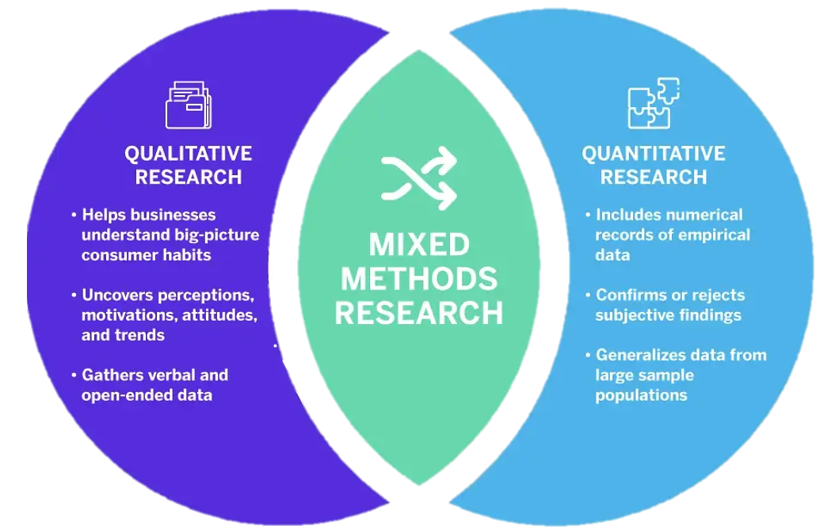
Selection of Design
A combination of qualitative and quantitative research method is used to get the best results.

Slide 14
Components
Quantitative Component
Qualitative Component
This aspect focuses on collecting numerical data through sensors integrated into the smart pond system. These sensors will monitor various environmental factors such as water quality, temperature, and pH levels, providing valuable data for system performance analysis.
This component aims to capture the user experience and perception of the Aquabot system. Through surveys, interviews, or feedback sessions, qualitative methods will help understand how users interact with the system, their satisfaction levels, and any improvements they suggest.

Slide 15
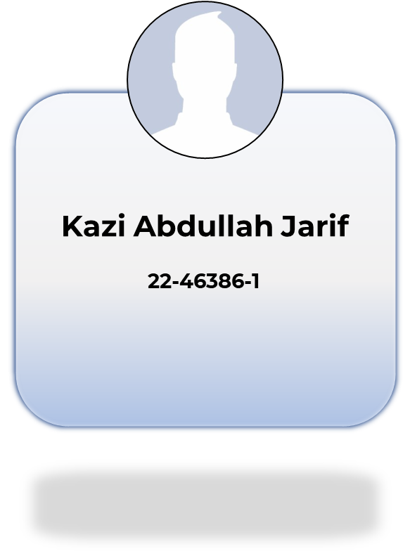

Slide 16
Research Variables
01
02
03
04
The independent variable is the cause. Its value is independent of other variables in the study.
Independent Variable
Water Temp
PH level
Turbidity
Solar Power
Utilization

Slide 17
Research Variables
02
01
The dependent variable is the effect. Its value depends on changes in the independent variable.
Dependent Variable
Fish Species
Recommendation
Fish Growth
Rate

Slide 18
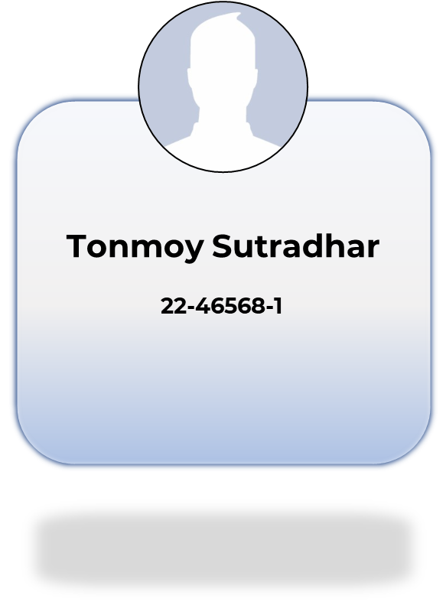

Slide 19
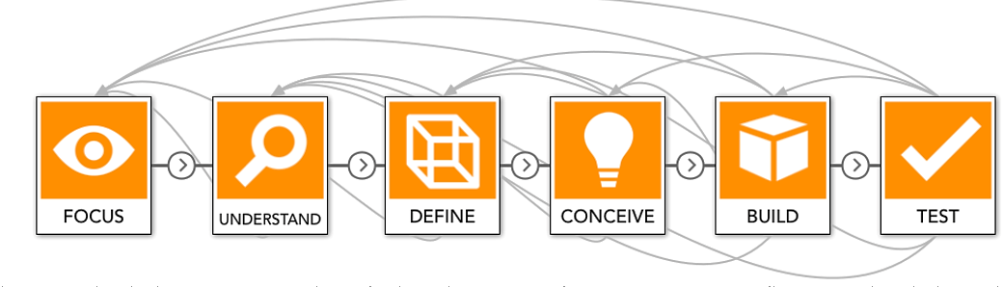
Scientific Method
The method we have used is basically an Application Based Research Method

Slide 20
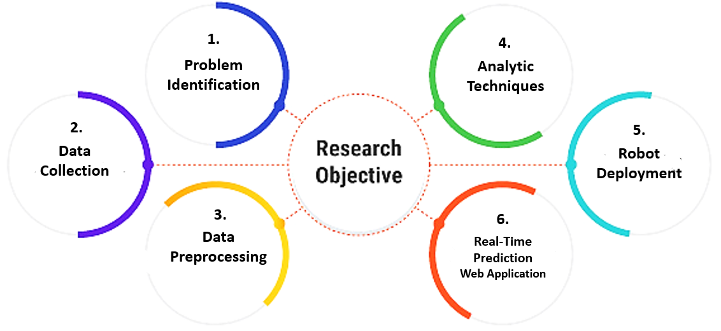
Step by step process to achieve the objective

Slide 21
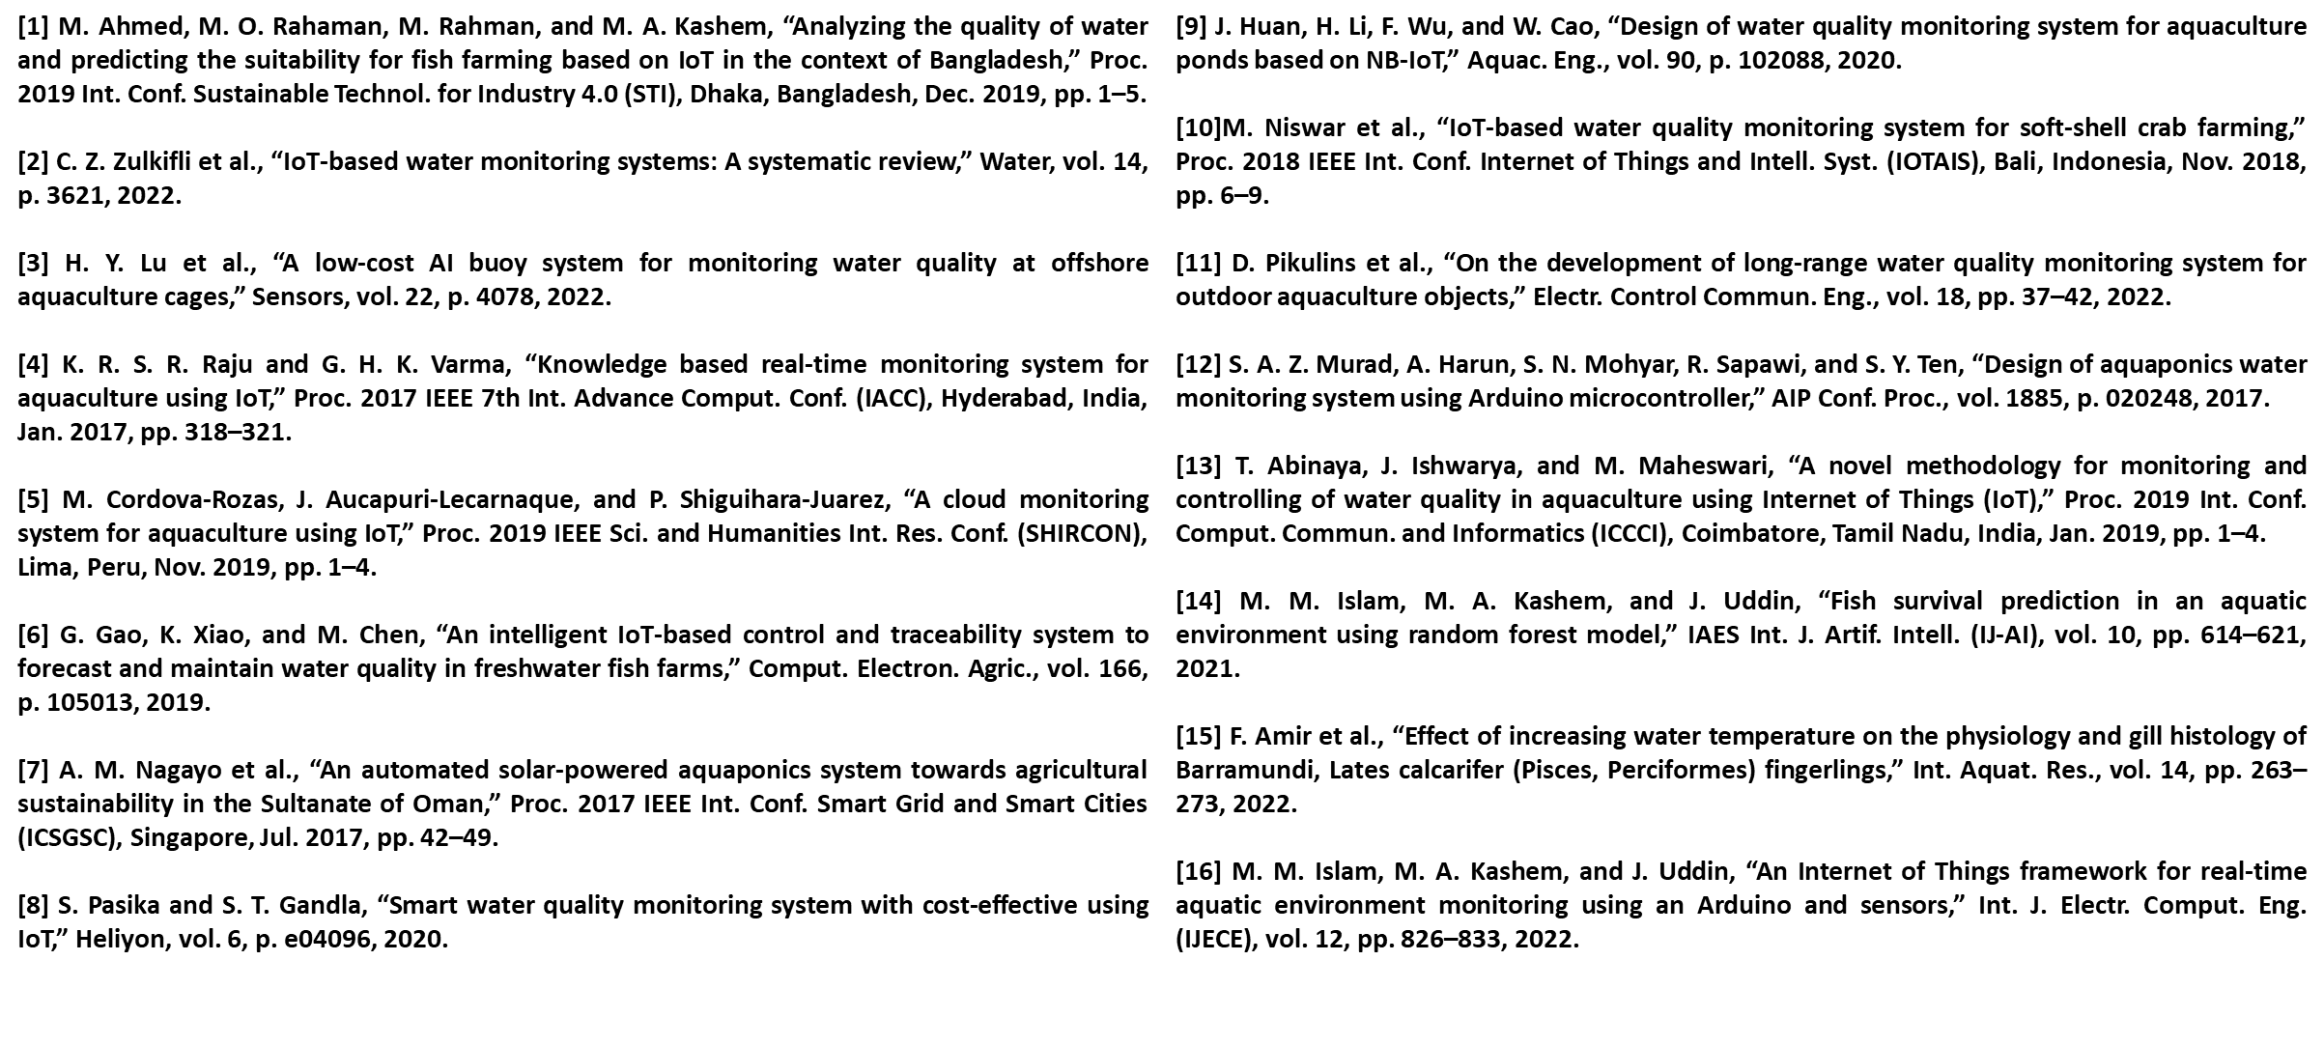
References

Slide 22
Thanks for being with us!
Do you have any questions?
Please keep this slide for attribution

